Slide 1

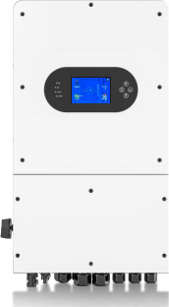






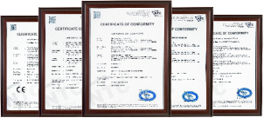
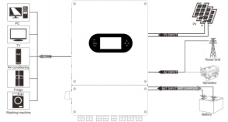

 |  | Data Sheet
CERTIFICATIONS PRODUCT CHARACTERISTICS
1 12 7.COM3 13.WIFI/RS232 4.PV2- 8.BAT+ 2 10 13 7 5 1.PV1+ 2.PV2+ 13.WIFI
LCD DISPLAY ICONS BASIC SYSTEM ARCHITECTURE
SINGLE PHASE HYBRID INVERTER
Model | PD0060G-SPM-EU
PV String Input Data
Max. DC Input Power (W) | 7800
Rated PV Input Voltage (V) | 370 (125~500)
Start-up Voltage (V) | 125
MPPT Voltage Range (V) | 150-430
Full Load MPPT Voltage Range (V) | 300-430
Max. DC Input Current(A) | 20+20
Max. DC Short Circuit Current(A) | 22+22
No.of MPPT Trackers | 2
No.of Strings per MPPT Tracker | 1+1
AC Output Data
Rated AC Output Power (W) | 6000
Max AC Output Power (W) | 6600
AC Output Rated Current (A) | 27.3
Max AC Output Current (A) | 30
Max.Continuous AC Passthrough (A) | 40
Peak Power (of grid) | 2 times of rated power, 10 S
Power Factor | 0.8 leading - 0.8 lagging
AC Output Frequency and Voltage | 50/60Hz; L/N/PE 220/230Vac
Grid Type | Single Phase
Total Harmonic Distortion (THDi) | <3% (of nominal power)
DC Current Injection | <0.5% (Rated Current)
Battery Input Data
Battery Type | Lead-acid or Lithium-ion
Battery Voltage Range (V) | 40~60
Max. Charging Current (A) | 135
Max. Discharging Current (A) | 135
External Temperature Sensor | Yes
Charging Curve | 3 Stages / Equalization
Charging Strategy for Li-Ion Battery | Self-adaption to BMS
Eﬃciency
Max. Eﬃciency | 97.60%
Euro Eﬃciency | 96.50%
MPPT Eﬃciency | 99.90%
Protection
Anti-islanding Protection | Yes
PV String Input Reverse Polarity Protection | Yes
Insulation Resistor Detection | Yes
Residual Current Monitoring Unit | Yes
Output Over Current Protection | Yes
Output Shorted Protection | Yes
Surge Protection | DC Type II/AC Type III
Over Voltage Protection | Yes
Certiﬁcations and Standards
Grid Regulation | IEC61727/EN50549-1
Safety EMC / Standard | IEC/EN 61000-6/2/4, IEC/EN 62109-1, IEC/EN 62109-2
General Data
Operating Temperature Range (℃) -40-60℃, >45℃ Derating
Cooling | Smart Cooling
Noise (dB) | ≤50 dB
Communication with BMS | RS485; CAN
Monitoring mode | WIFI ，APP
Weight (kg) | 24
Size (W x H x D mm) | 580x330x252mm
Protection Degree | IP65
Installation Style | Wall-mounted
Warranty | 5 Years （10Years Optional）
PD0060G-SPM-EU FEATURES
COLORFUL TOUCH LCD, IP65 PROTECTION DEGREE | AC COUPLING TO RETROFIT EXISTING SOLAR SYSTEM
 |  | MAX. 16 PCS PARALLEL FOR ON-GRID AND Oﬀ-GRID OPERATION;SUPPORT MULTIPLE BATTERIES PARALLEL
MAX. CHARGING/DISCHARGING CURRENT OF 135A
 |  | SUPPORT STORING ENERGY FROM DIESEL GENERATOR
 | 6 TIME PERIODS FOR BATTERY CHARGING/DISCHARGING
1.PV1+
3.PV1-
5.COM1
6.COM2
10.GEN
11.LOAD
12.GRID
2.PV2+
9.BAT-
11
3
4
8
6
9
3.PV1-
4.PV2-
5.COM1
6.COM2
7.COM3
8.BAT+
9.BAT-
10.GEN
11.LOAD
12.GRID
12/21/2023 18:23 0 8 0kw N0 0 8 0kw
Thu
0 8
0kw
0
5
8
0kw

